Slide 1


Final Year Project
Lung Disease Diagnosis Using Multiscale Convolutional Neural Network
Supervised By: Mr.Muhammad Hassaan Ashraf (Lecturer)

Slide 2
Project Team
Abdul Hadi Umair (36958)
Zeeshan Rangbaz (36957)
Touseef Ahmed (38271)

Slide 3
Table of Content
Background and Introduction
Literature Review
Problem Statement
Project Scope
Proposed Solution
Requirements Summary
Design Summary
Methodology
Implementation Summary
Experiments and Results Summary
Testing Summary
Conclusion and Outlook

Slide 4
Overview
Framework Overview:
This project compares the performance of popular CNN models like VGG16, ResNet, Inception V3, Mobile Net, and DenseNet for diagnosing lung diseases using CT-Scans and Chest X-Rays datasets.
DenseNet performed the worst on CT_XRAY_Combine dataset.
TZH_Model performed the best on CT_XRAY_Combine dataset.
Key Features:
Studies how plain feed-forward, multi-level, and multi-scale features affect different CNN models.
Uses advanced preprocessing methods like Gaussing Filter & CLAHE.
Explores the impact of modern activation functions, such as Swish and ReLU, on model optimization and performance.

Slide 5
BACKGROUND AND INTRODUCTION

Slide 6
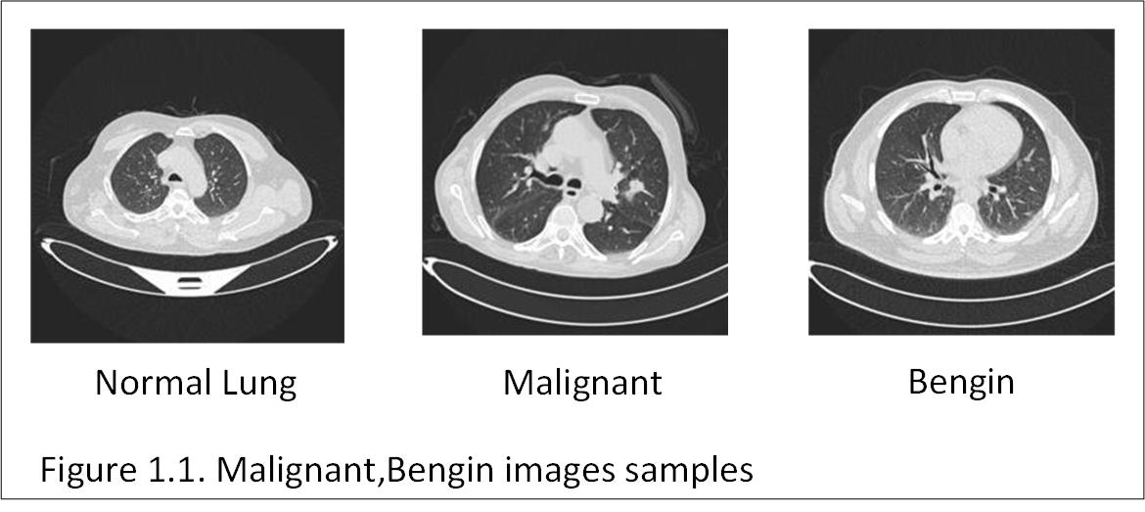
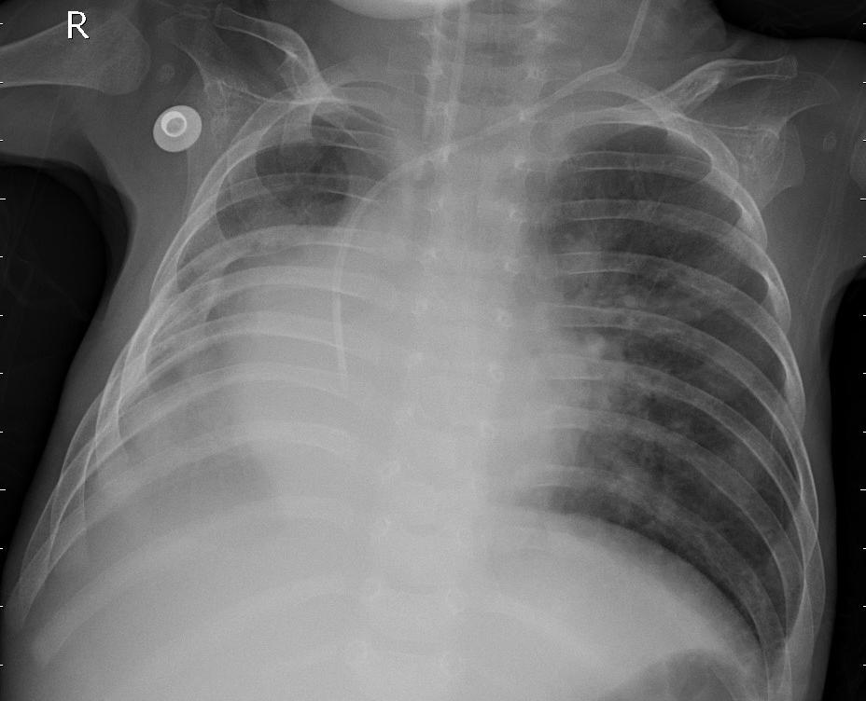
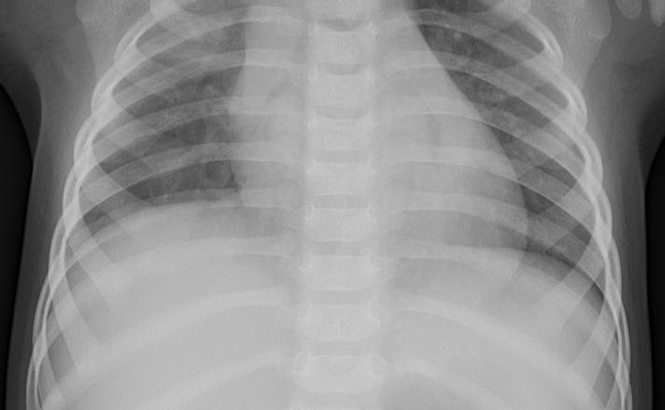
Background and Introduction(1/3)
Lung Disease
Lung diseases, such as pneumonia, Bengin, and interstitial lung disease, are among the leading causes of global morbidity and mortality.
Early detection is crucial for effective treatment, but traditional diagnostic methods face challenges due to variability in imaging data and subtle disease patterns.
Pneumonia
Normal
Figure 1. CT-Scan Images Sample
Figure 2. X-Ray Images Sample

Slide 7
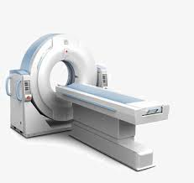
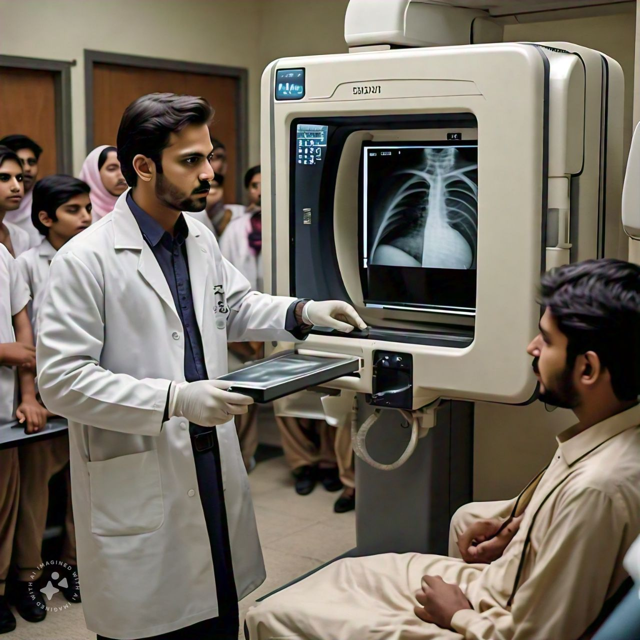
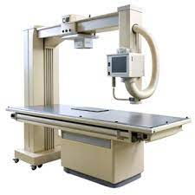
Background and Introduction (2/3)
Classical Methods:
Manual interpretation by radiologists using CT-Scans and Chest X-Rays (as shown in Figure 3,4 and 5).
Time-consuming, subjective, and prone to variability in diagnosis.
Figure 3. CT-Scan Machine
Figure 4. X-Ray Machine
Figure 5. X-Ray Machine

Slide 8
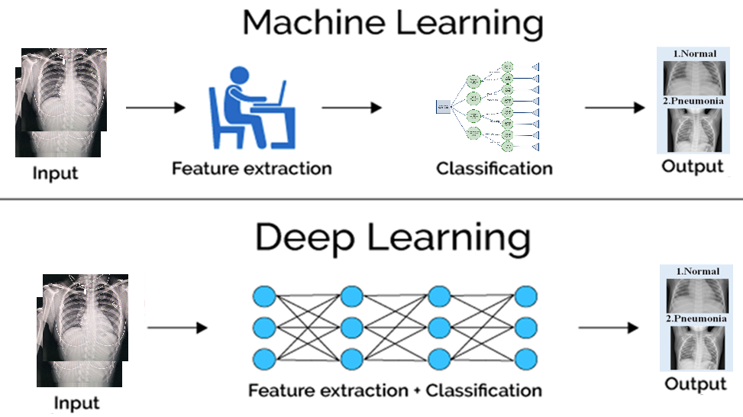
Background and Introduction (3/3)
Vision-Based Automated Methods:
Leverage machine learning and computer vision for image analysis (as shown in Figure 5).
Recent advances include Deep Learning and Convolutional Neural Network (CNN) techniques for accurate and reliable diagnosis.
Figure 6. Machine Learning vs Deep Learning based techniques

Slide 9
Literature Review

Slide 10
Ref | Contribution
Lakshmi and Nagaraj [8] | Proposed Squeeze-Inception V3, enhanced with Slime Mould Algorithm (SMA)-based feature extraction. Preprocessing steps involve converting images to the YCbCr color space, applying data augmentation techniques like vertical and horizontal flips and 90-degree rotations, resizing, and normalization. The ReLU activation function is employed in the model.
Nahiduzzaman et al. [9] | Proposed a parallel CNN and Extreme Learning Machine (ELM) model for detecting multiple lung diseases, including COVID-19, from chest X-ray (CXR) images. The study utilized the ChestX-Ray14 dataset, supplemented by pneumonia images from Kaggle, comprising a total of 24,770 training and 6,193 testing images. Key preprocessing techniques included image rescaling, while the Adam optimizer and ReLU activation functions were employed.
Yi et al. [7] | The proposed framework consists of three main steps: bone suppression to reduce interference from bone structures, pulmonary parenchyma extraction using the IU-Net segmentation network, and disease diagnosis with the RCA module for feature extraction. Datasets from Kaggle were used, with COVID-19 radiography data and other lung disease images for training and testing. Despite its success, the framework acknowledges limitations such as potential information loss behind bone structures, presenting opportunities for future improvement.
Gayathri et al. [10] | CNNs were used for feature extraction, sparse autoencoders for dimensionality reduction, and Feedforward Neural Networks (FFNNs) for classification. Pre-trained networks such as InceptionResNetV2, Xception, and ResNet101 were utilized. The ReLU activation function is applied in the convolution layers to handle non-linearity. The combination of Xception and ResNet101 achieved the maximum performance.

Slide 11
Ref | Contribution
Liu et al. [11] | Proposed a Multi-scale Capsule-weighted Fusion Classification Network (MCFCN). The model integrates capsule networks to address challenges in small-scale feature extraction and lesion differentiation. Various learning techniques, including CNNs, transfer learning, and attention mechanisms, were employed to enhance the model's feature extraction capabilities. For training, they utilized the COVID-19 CT Scan Slice Dataset and the COVID-CT-MD, comprising 18,000 slices.
Lanjewar et al. [6] | The DenseNet model was adapted to enhance the detection of lung diseases from CT scans, incorporating various feature selection methods to improve accuracy and efficiency. The study utilized classifiers such as Support Vector Machine (SVM), Random Forest (RF), Decision Tree (DT), Gaussian Naive Bayes (GNB), and K-Nearest Neighbors (KNN) to optimize the detection process.
Arun Prakash et al. [12] | Focused on enhancing diagnostic accuracy for pediatric pneumonia detection by integrating machine learning and deep learning techniques, specifically leveraging various deep learning architectures, attention mechanisms, and ensemble methods on chest X-ray images. Utilizing deep CNNs like ResNet50V2, ResNet101V2, Xception, and DenseNet169, the approach incorporates a channel attention module to refine feature extraction.

Slide 12
Ref | Contribution
Sravani et al. [13] | The study employed VGG16 and InceptionV3 CNNs for analyzing lung images. Key methodologies included image quality enhancement through an enhanced super-resolution model, transfer learning to leverage pre-trained models, and data augmentation techniques such as blurring and rotation to increase dataset size and reduce overfitting risk. The dataset utilized was the LUNA-16 from Kaggle, containing 746 lung images. Preprocessing steps involved background removal and contrast enhancement.
Qi et al. [14] | The methodology involved several key components: LinkNet was employed for lung segmentation, accurately delineating the lung field with infected lesions. A capsule network automatically selected critical slices containing lesions, followed by another capsule network for slice-level prediction of COVID-19 versus CAP.
Shaik and Cherukuri [15] | Introduced a novel ensemble classifier for detecting COVID-19 from chest CT scans, leveraging transfer learning with multiple pre-trained deep learning models, including VGG16, ResNet50, and MobileNet. By fine-tuning these models and combining their predictions, the proposed approach addresses the limitations of single-model predictions, achieving state-of-the-art accuracy. The ensemble classifier integrates a preprocessing module and a regularized classification head, utilizing confidence scores to enhance performance. Experiments on the SARS-CoV-2 and COVID-CT datasets yielded notable results. The use of Generative Adversarial Networks (GANs) for data augmentation and Principal Component Analysis (PCA) for dimensionality reduction further improved classification performance. This study emphasizes the effectiveness of CT scans for rapid COVID-19 diagnosis and highlights the robustness of the proposed ensemble methodology compared to existing techniques.

Slide 13
Ref | Contribution
Gaur et al. [16] | Proposed a method for identifying COVID-19 from chest CT images by integrating Empirical Wavelet Transformation (EWT) with transfer learning utilizing the DenseNet121 model. This approach aims to enhance the accuracy of COVID-19 detection. The methodology involved preprocessing CT images via EWT, focusing on the red, green, and blue channels, followed by feature extraction. Classification was performed using DenseNet121, achieving an accuracy of 85.5% and an F1 score of 85.28%. The study utilized the publicly available SARS-CoV-CT dataset, comprising 1,252 COVID-19 CT images and 1,230 negative cases collected from patients in São Paulo, Brazil. Data augmentation techniques were employed to mitigate overfitting.
Khattab et al. [17] | Conducted a comprehensive study to evaluate the performance of various deep learning models, specifically CNNs, for detecting COVID-19 and pneumonia from chest X-ray images. The study employed several transfer learning models, including InceptionResNetV2, InceptionV3, Xception, and MobileNet, to enhance classification accuracy. To address dataset challenges, data preprocessing techniques such as image resizing, normalization, and data augmentation (flipping, rotation, zooming) were implemented. The Focal Loss function was utilized to mitigate class imbalance issues. Results indicated that InceptionResNetV2 achieved the highest accuracy of 88.47% on the COVID-19 radiography dataset.
Rajeswari and Arunesh [18] | Proposed an ensemble-modified classifier for pneumonia diagnosis, focusing on improving predictive accuracy in resource-limited areas. The study utilized deep CNNs, specifically InceptionV3, for feature extraction from chest X-ray images. Transfer learning was employed to fine-tune models, and Neighborhood Component Analysis (NCA) was used to fuse features from CNN and InceptionV3 models. Various classifiers, including XGBoost, Random Forest, and Naïve Bayes, were applied. Preprocessing techniques such as resizing, normalization, augmentation, and conversion to arrays enhanced the dataset quality. The model employed the ReLU activation function for hidden layers, the sigmoid activation function for output, and the Adamax optimizer for training, demonstrating its efficacy in pneumonia detection.

Slide 14
Data Extraction Table
Author(s) & Year | Model/Architecture | Application | Key Methods/Techniques | Key Findings
Lakshmi and Nagaraj (2021) | Squeeze-Inception V3 with Slime Mould Algorithm (SMA) | Lung Cancer Diagnosis | Slime Mould Algorithm | Slime Mould Algorithm for better performance
Sravani et al. (2022) | VGG16, InceptionV3 | Lung Nodule Detection | Model evaluation and comparison | VGG16 outperformed InceptionV3 in lung nodule detection
Shaik and Cherukuri (2021) | ResNet50 + VGG16 (Ensemble Model) | COVID-19 Detection | Transfer learning, Data augmentation | Ensemble model improved performance for COVID-19 detection
Lanjewar et al. (2022) | DenseNet201 | Lung Cancer Detection | Modified DenseNet, CT-Scan Data | Good validation accuracy in lung cancer detection
Arun Prakash et al. (2022) | ResNet50V2 + DenseNet169 | Pediatric Pneumonia Diagnosis | Attention mechanisms, Transfer learning | High accuracy achieved in pediatric pneumonia diagnosis
Rajeswari and Arunesh (2021) | InceptionV3 | Pneumonia Detection | Feature fusion | Improved predictive accuracy with feature fusion

Slide 15
Plain Feed Forward
A simple feed-forward network is the most basic type of neural network. It consists of multiple layers of neurons, where information flows in one direction from the input layer to the output layer. Each neuron processes information and passes it to the next layer.
Key features of feed-forward networks:
They are straightforward and easy to train.
They work well for basic problems but may struggle with complex tasks like analyzing medical images, which require capturing spatial and hierarchical information.

Slide 16
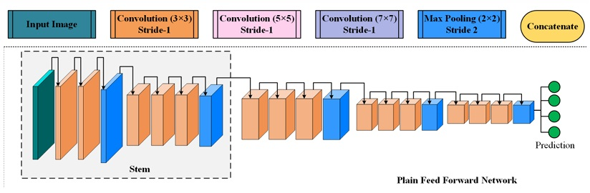
Plain Feed Forward
While simple feed-forward networks are useful for small datasets or less complex problems, they are not ideal for tasks like lung disease diagnosis, where understanding image structure is crucial.
Figure 7. Plain Feed Forward

Slide 17
Multilevel
Multi-level or multi-scale networks are designed to address the limitations of simple architecture by capturing details at different scales. In medical imaging, diseases can appear in various sizes and patterns. For example, a tumor might be a small spot, while pneumonia could spread across a large area of the lung.
Key characteristics of multi-scale networks:
Multiple Kernel Sizes: These networks use filters of different sizes to capture both small and large patterns in images.
Hierarchical Learning: They combine features learned at different levels to provide a more detailed understanding of the image.
Improved Accuracy: By considering multiple scales, these networks can better differentiate between similar conditions, such as healthy lungs and early-stage lung disease.

Slide 18
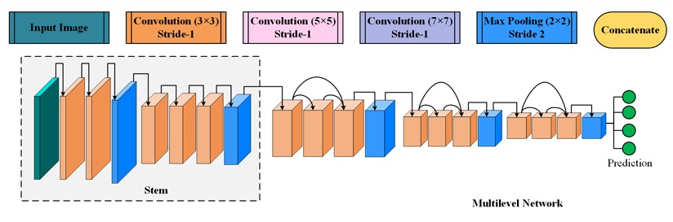
Multilevel
Multi-scale architectures are particularly effective for diagnosing lung diseases because they can detect both subtle and prominent abnormalities, leading to better results compared to traditional single-scale methods. The Multilevel/Scale architecture are shown on Figure 10 and 11
Figure 8. Multilevel

Slide 19
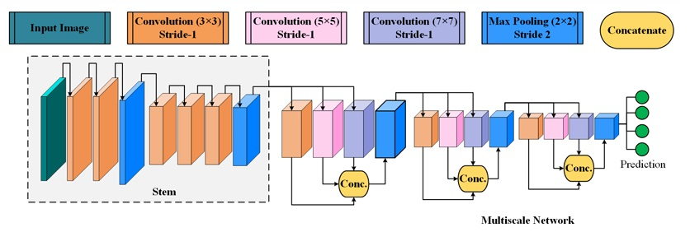
Multiscale
Figure 9. Multiscale

Slide 20
Problem Statement
Early-Stage Disease
Due to the loss of fine-grained regional details, traditional models struggle to detect diseases at an early stage, particularly when the abnormalities are subtle or localized.
Layer-to-Layer Feature Loss
As information passes from one layer to the next, critical features may be lost.
Vanishing Gradient Problem
In deep neural networks, gradients can diminish as they are propagated backward through layers during training.
This issue slows down the training process and may prevent the network from learning.

Slide 21
Project Scope
The scope of a project is to design and develop a web-based lung disease diagnosis system that leverages a deep learning model specifically, a TZH_Multiscale Convolutional Neural Network (MCNN) to analyze chest X-ray or Ct-scan images and predict potential lung disease. This project aims to assist medical professionals in making quicker and more accurate diagnoses through an accessible web interface.
Work Collaboration:
Model research and development
Frontend and Backend Web Application
MCNN Model Integration
System testing and documentation.
The system currently diagnoses common lung conditions (e.g., pneumonia, Malignant & Benign).

Slide 22
Proposed Solution
We propose a model for the early detection of lung diseases using a TZH_Multiscale Convolutional Neural Network (MCNN).
The key highlights of the proposed model are:
MCNN Features: The MCNN model leverages both multilevel and multiscale feature extraction to improve the accuracy of detecting subtle and localized abnormalities in chest X-rays And Ct-Scan.
Robust Feature Extraction using Dilation: By employing dilated convolutions, the model effectively captures detailed features without losing spatial resolution, enhancing its ability to identify diseases in small regions.

Slide 23
Requirements
List of Stakeholders
Patient
Doctor
Admin
2) Use Cases
We have identified 37 use cases according to requirements
3) Functional Requirements
We have identified 49 Functional Requirements.
Admin 20 FR’s
Patient 15 FR’s
System 2 FR’s
Doctor 12 FR’s

Slide 24
Requirement Summary
The system is designed to serve multiple stakeholders, including Patients, Doctors, and Administrators, each with specific roles and requirements within the lung disease diagnosis platform.
Patients can upload chest X-ray images and receive diagnostic results through an intuitive web interface.
Doctors can view patient submissions, interpret results, and provide medical feedback or consultations.
Administrators manage user accounts, oversee system activity, and ensure smooth operation and data integrity across the platform.
These requirements collectively form the foundation of the system’s design and ensure that each stakeholder’s needs are met effectively within the platform.

Slide 25
Design Summary
Frontend (User Interface):
Built with HTML, CSS, and Java Script
Backend (Server Logic):
Developed using Django (Python-based web framework)
Handles routing, file uploads, and prediction handling
Model Integration:
MCNN model trained in Google Colab
Model saved as a .h5 file and downloaded locally
Loaded in Django backend using TensorFlow for local prediction
Database Uses Django (SQLite) to store:
User accounts
Image uploads
Prediction history

Slide 26
Design Summary
This architecture allows the model to capture both fine-grained local patterns and broader contextual information simultaneously, which is crucial for identifying subtle abnormalities in medical imaging.
The model architecture begins with parallel convolutional blocks, each with different kernel sizes (e.g., 3×3, 5×5, and 7×7), enabling multiscale feature learning.
The outputs of these parallel layers are then concatenated and passed through pooling, dropout, and fully connected layers for classification.
The final layer uses a softmax activation to predict the probability of different lung diseases.
The model was trained using labeled chest X-ray & Ct-scan dataset, with extensive preprocessing including normalization, resizing, and data augmentation to improve generalization. Loss functions such as categorical cross-entropy and optimizers like Adam were used to ensure stable convergence.

Slide 27
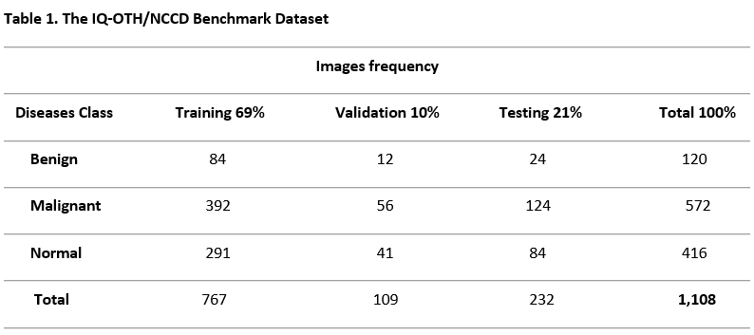
Data Collection And Preprocessing (1/4)
Data Collection
Dataset - IQ-OTH/NCCD:

Slide 28
Methodology

Slide 29
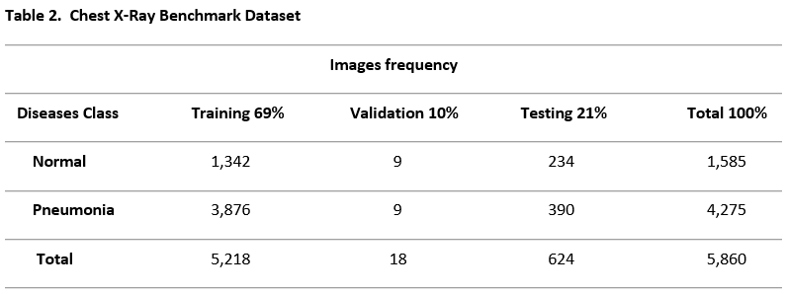
Data Collection And Preprocessing (2/4)
Data Chest X-Ray:
Dataset - Chest X-Ray:

Slide 30
Data Collection And Preprocessing (3/4)
2. Image Preprocessing
Resizing: Standardized all images to 224x224 pixels using Bicubic interpolation, ensuring consistency and compatibility with CNN architectures.
Gaussian Filter to handle Pixel Adversarial Attack
Contrast Enhancement: Applied CLAHE (clip limit: 2, tile size: 8) to improve image visibility and highlight diagnostic features.
Figure 7. Data Preprocessing

Slide 31
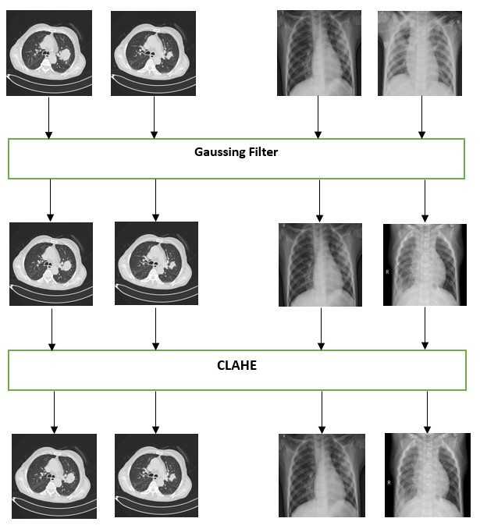
Data Collection And Preprocessing (4/4)
Figure 10. Data Collection & Preprocessing

Slide 32
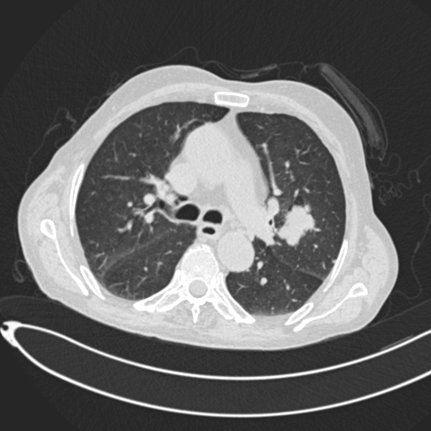
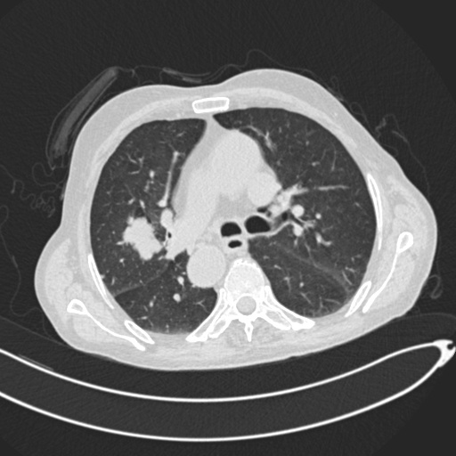
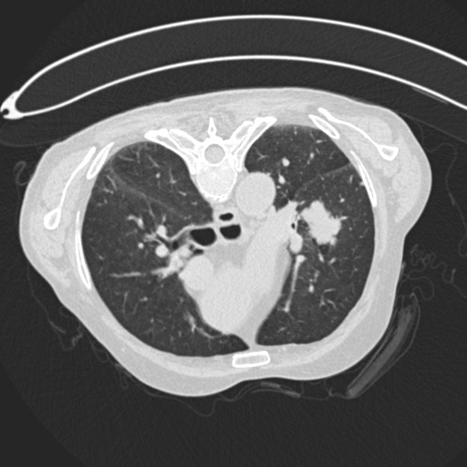
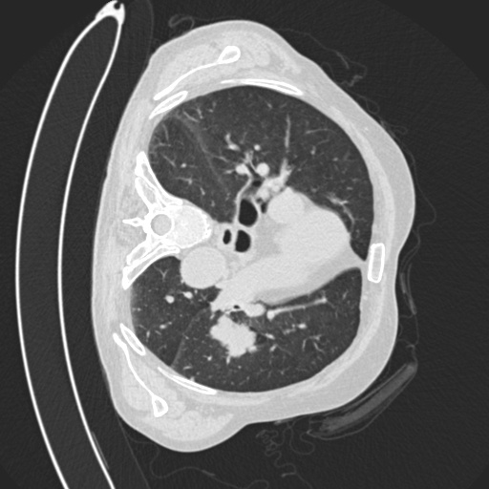
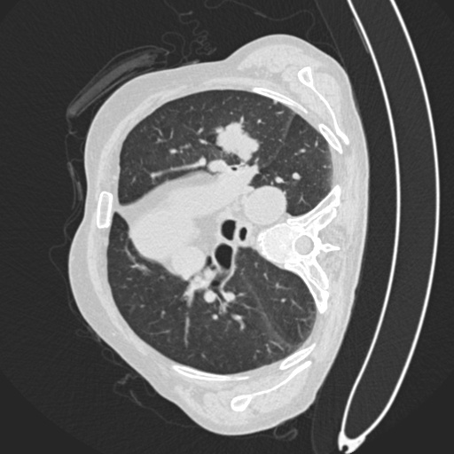
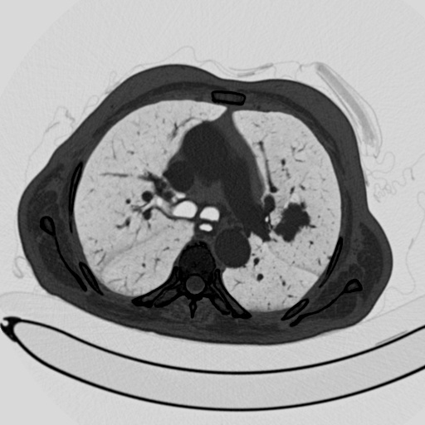
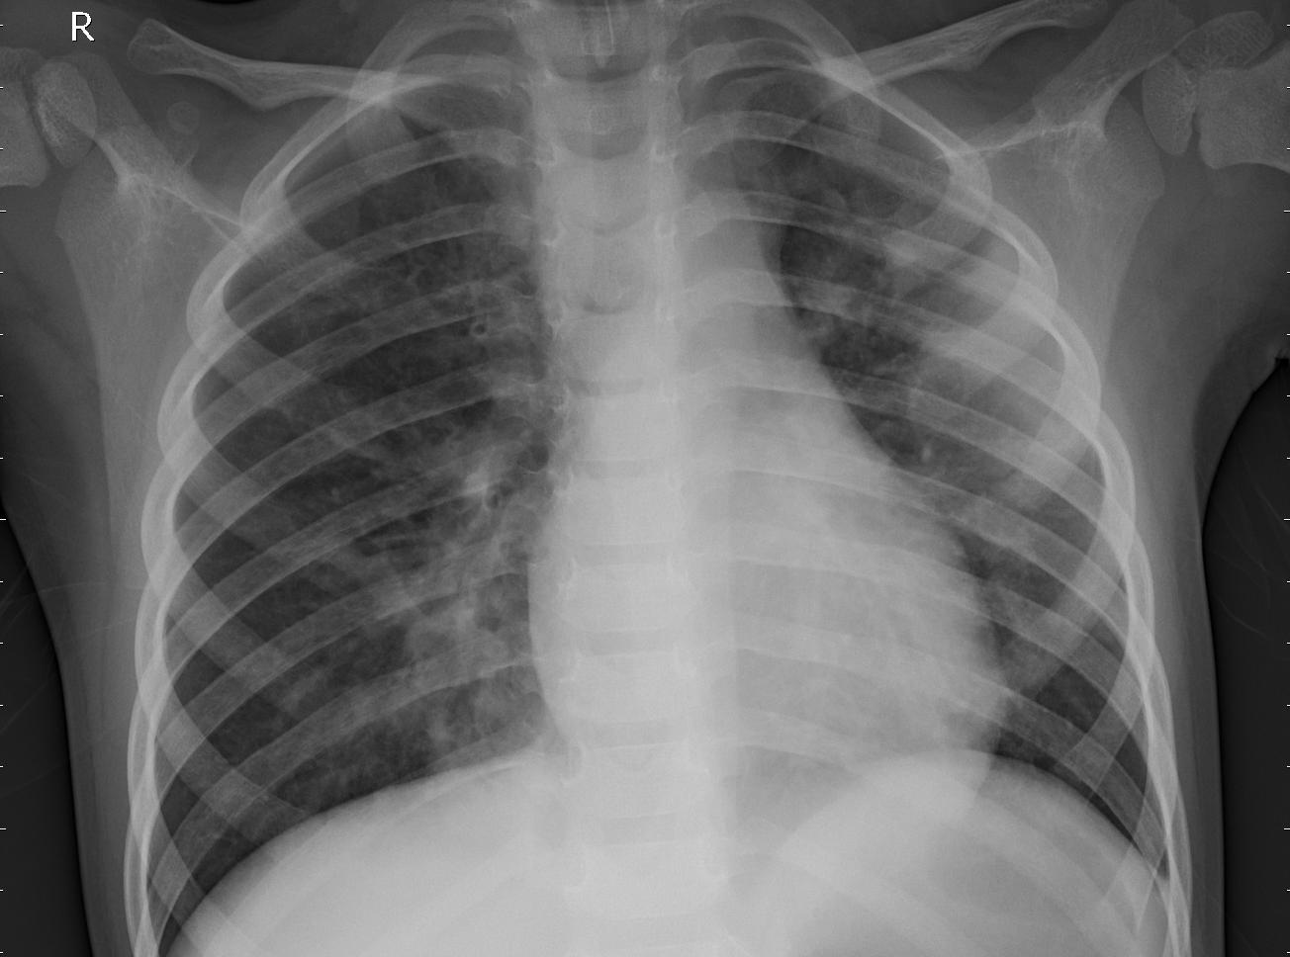
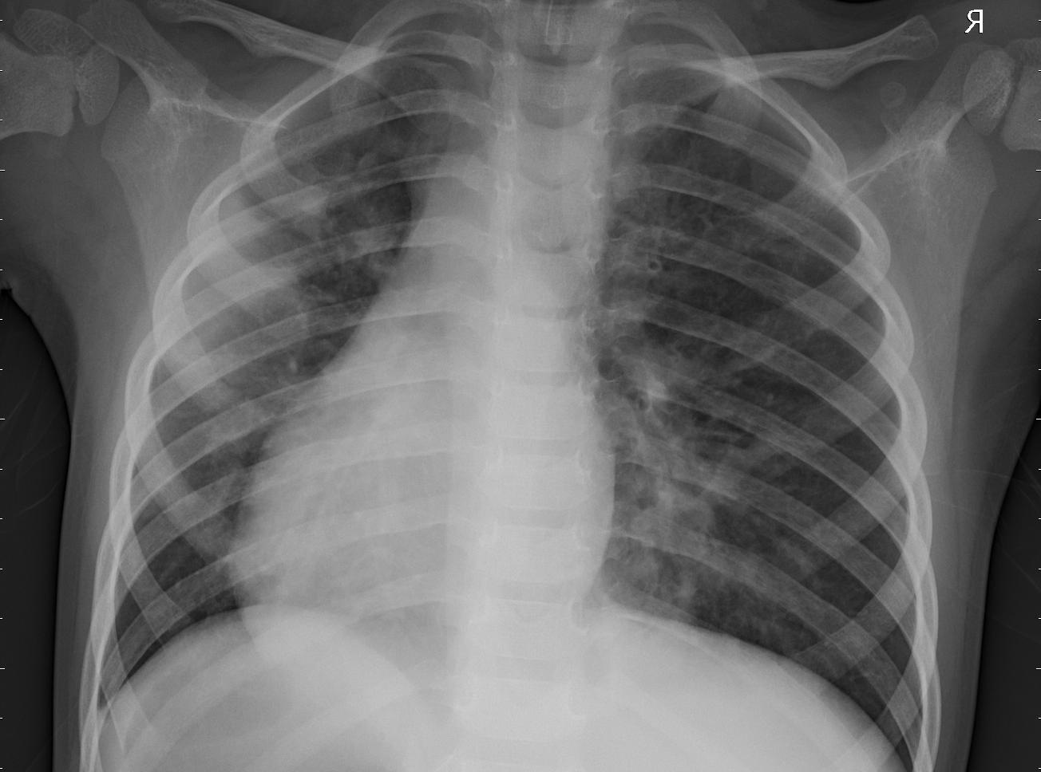
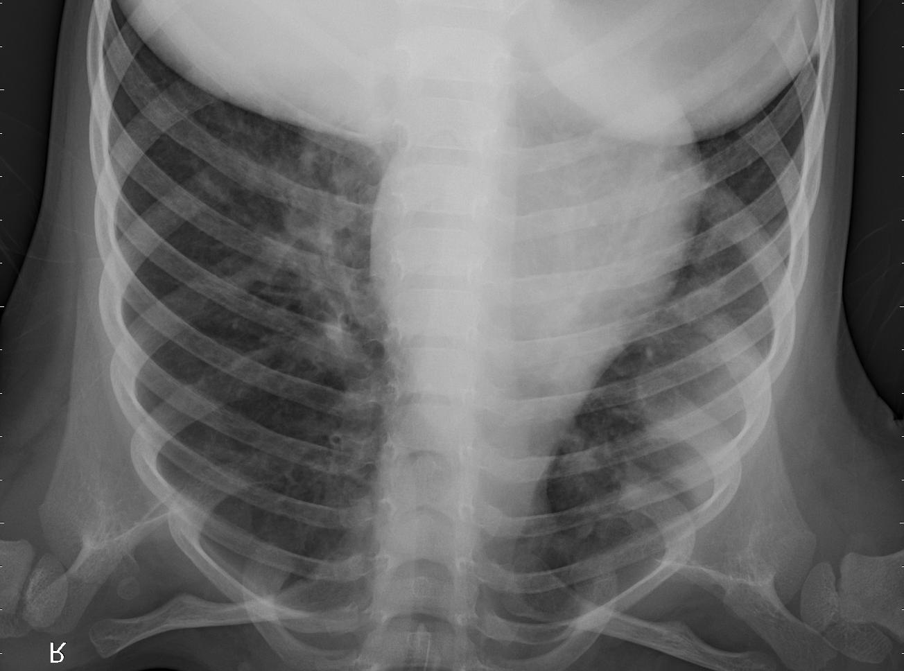
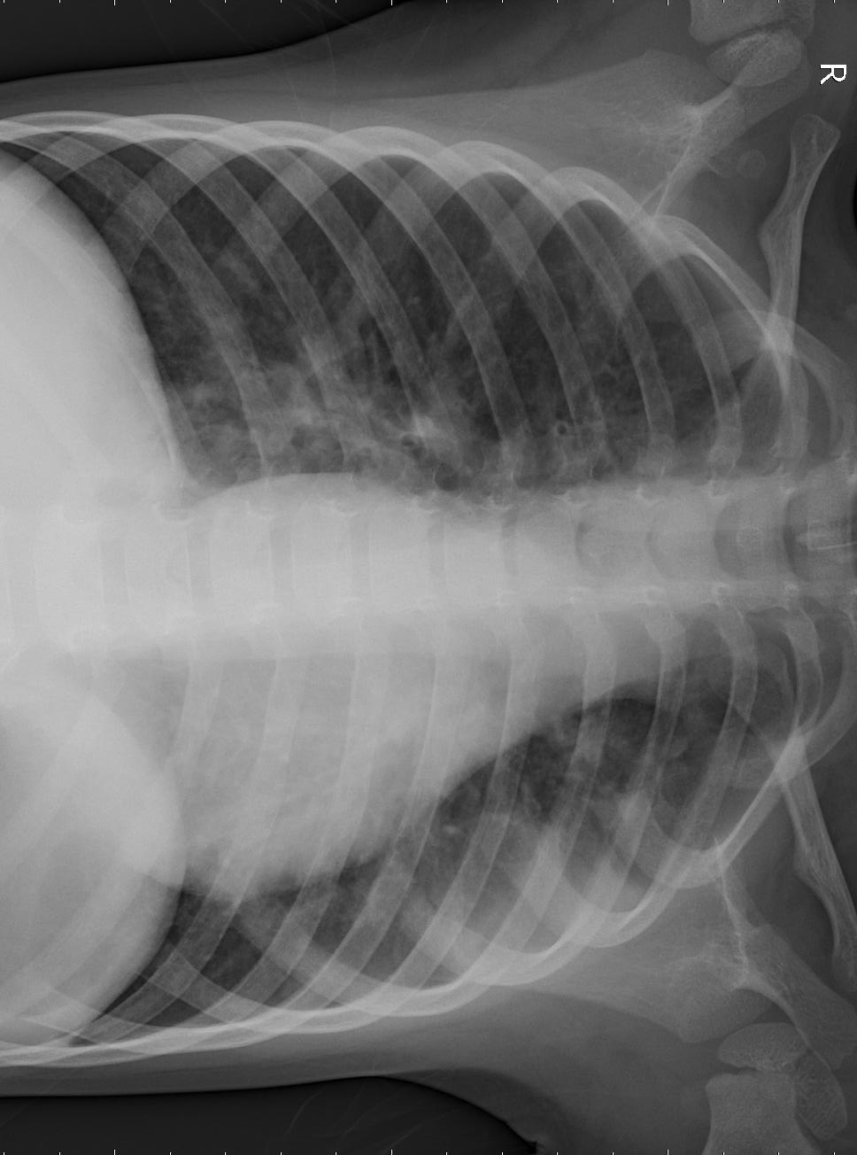
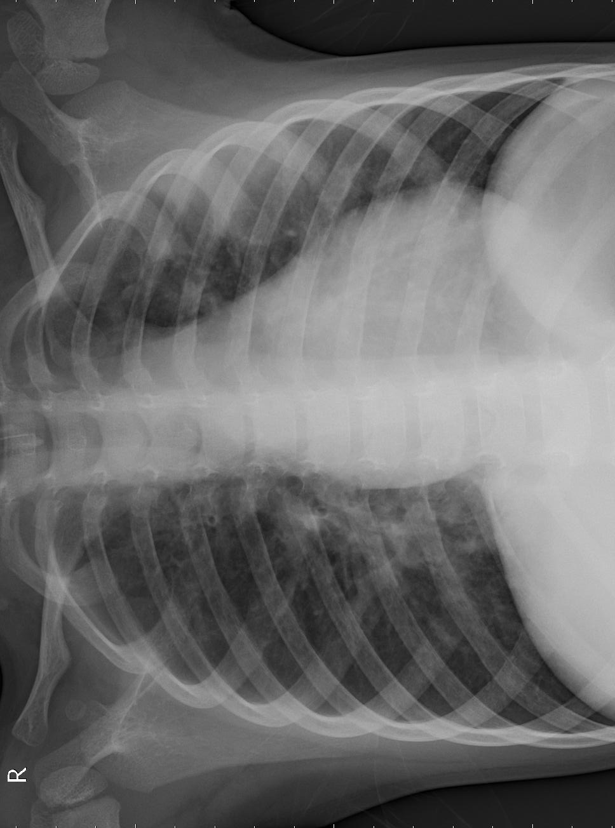
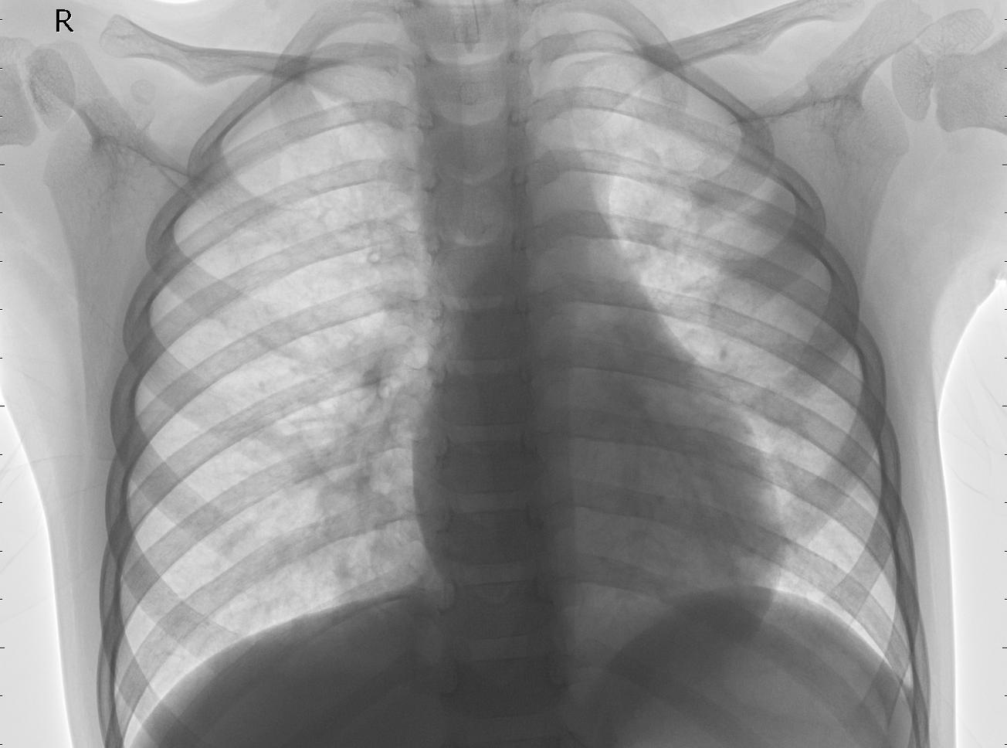
Data Augmentation
a) Original
b) Flip Horizontal
c) Flip Vertical
d) Rotate 90
e) Rotate 120
f) Image Negative
a) Original
b) Flip Horizontal
c) Flip Vertical
d) Rotate 90
e) Rotate 120
f) Image Negative
Figure 11. Data Augmentation

Slide 33
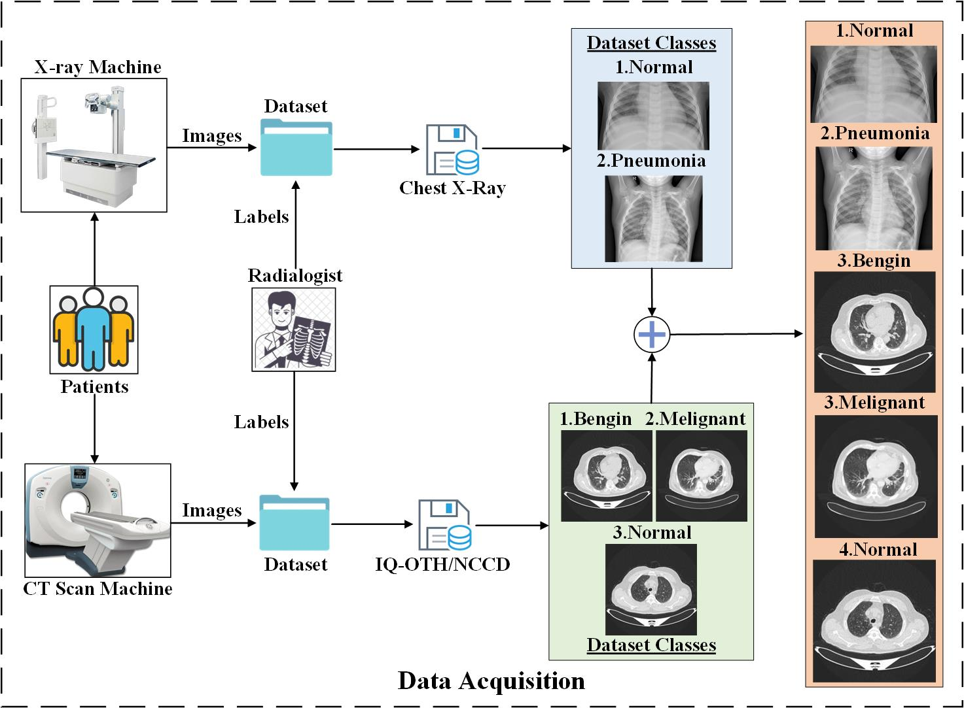
Data Acquisition
Figure 12. Data Acquisition

Slide 34
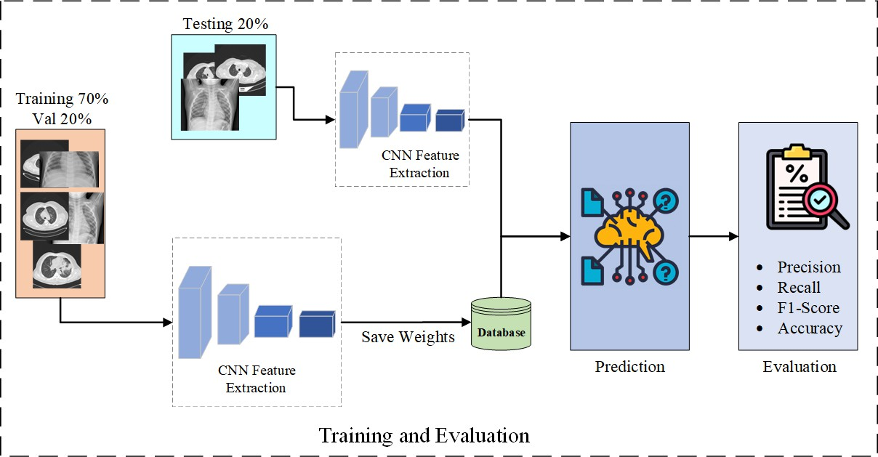
Splitting Training and Testing
Figure 13. Splitting training and testing

Slide 35
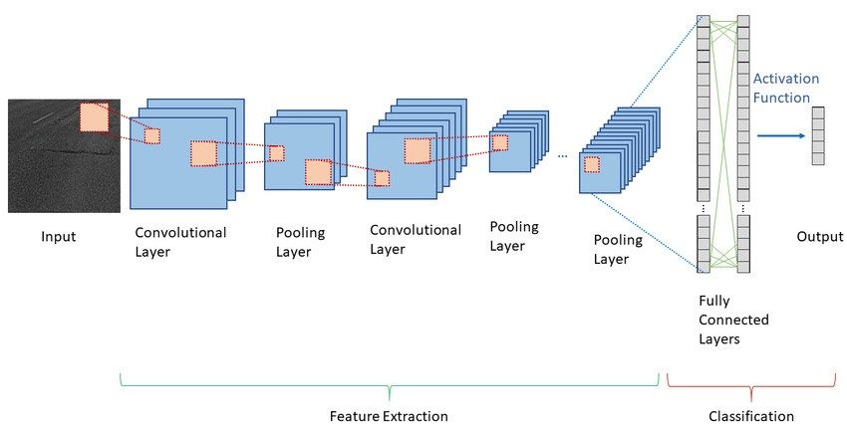
Principle of CNN Architecture
CNNs are widely used in medical imaging because they can identify subtle patterns in images, which might be difficult for humans to spot. The principle of CNN architecture is shown in Figure 8.
Figure 14. Principle of CNN Architecture

Slide 36
Principle of CNN Architecture
Convolutional Neural Networks (CNNs) are a special type of deep learning model designed to work with image data. CNNs automatically learn features from images by applying filters in layers. These filters help detect patterns, such as edges, shapes, and textures, which are critical for tasks like diagnosing lung diseases.
The main components of a CNN include:
Convolutional Layers: These layers apply filters to the image to extract important features.
Pooling Layers: These layers reduce the size of the feature maps to make the model efficient and focus on the most important details.
Fully Connected Layers: These layers combine all the features and make predictions, such as whether the lungs are healthy or show signs of disease.

Slide 37
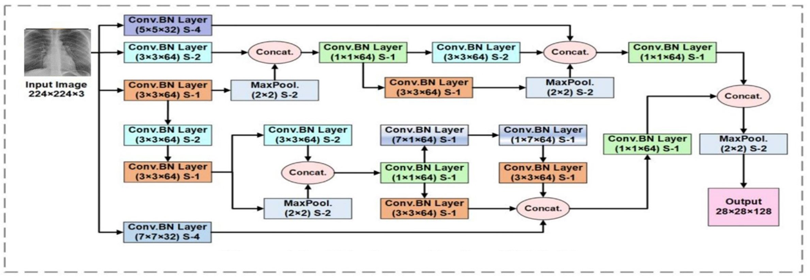
Proposed TZH_MCNN Architecture
Figure 15. Proposed TZH_MCNN Stem

Slide 38
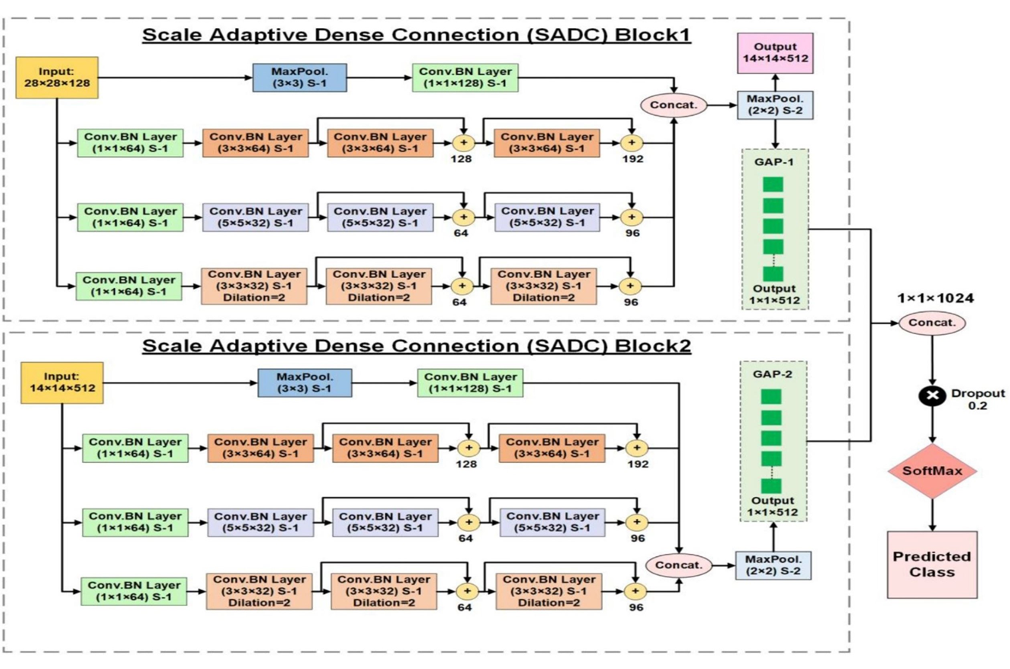
Figure 16.TZH_Proposed_MCNN Branches

Slide 39
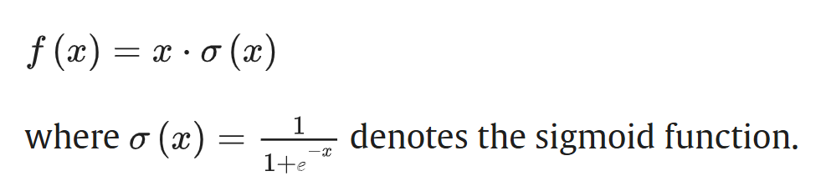
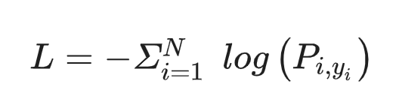
Activation and Loss function
Activation Function
Loss Function

Slide 40
Implementation
List of Development Technologies/ libraries
Python
Tensor flow
Django
Html
Css
Bootstrap
Java script

Slide 41
Implementation
List of Development Tools
VS Code
GitHub
Colab
MS Word

Slide 42
Implementation Summary
The dataset underwent extensive preprocessing including normalization, resizing, grayscale conversion, and data augmentation (rotation, flipping) to enhance generalization.
The MCNN architecture consists of parallel convolutional layers with different kernel sizes (e.g., 3×3, 5×5, 7×7), enabling the model to learn features at multiple spatial scales.
After convolution and pooling layers, the model transitions through fully connected layers and ends with a softmax classifier for multi-class prediction.
The model was trained on labeled datasets and optimized using the Adam optimizer with categorical cross-entropy as the loss function.
Once trained and evaluated with high performance metrics (over 91% accuracy), the model was saved as a .h5 file and integrated directly into the Django backend.

Slide 43
Implementation Summary
The trained model was then saved as a.h5 file and integrated into the Django backend by loading it with tensorflow for real-time inference.
The web application frontend was developed using HTML, CSS, and JavaScript
The backend handled user requests, file uploads, and predictions. Users can upload chest X-ray or ct-scan images, which are processed through the MCNN model to generate disease predictions displayed on the results page.
The system includes separate dashboards and functionalities for patients, doctors, and admins. The integration was thoroughly tested to ensure smooth model inference, correct handling of image data, and reliable display of output. The final implementation delivers a complete end-to-end solution that combines AI-driven diagnosis with a responsive and accessible web interface.
This local integration enables fast, secure, and efficient AI-based lung disease detection without relying on external servers or APIs.

Slide 44
Experiments Summary
During the experimentation phase, we evaluated multiple deep learning models on both single-dataset and combined-dataset
These models showed moderate performance, typically achieving accuracies ranging between 56% to 80%, such as VGG16, ResNet50, and MobileNet, DensNet, Inception V3 which were fine-tuned for our classification task. Although they performed better than standard CNNs, their accuracy remained below expectations—especially when trained on combined datasets.

Slide 45
Results Summary
We developed and trained a Multiscale Convolutional Neural Network (MCNN).
By leveraging multiple convolutional layers with varying kernel sizes, MCNN was able to extract both local and global features effectively.
When trained on the combined dataset, our MCNN model achieved a significantly higher accuracy of over 91%, outperforming all previously tested models.
This confirmed the effectiveness of multiscale feature extraction in improving classification performance across CT_XRAY_Combine dataset.

Slide 46
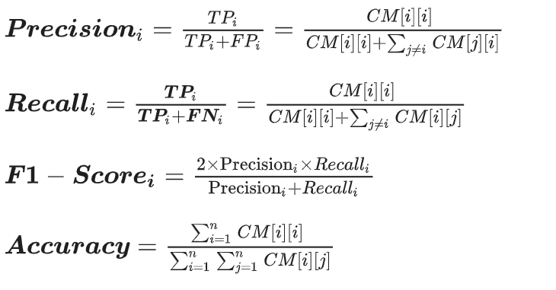
Evaluation metrics
Performance metrics for each class

Slide 47
Model training and evaluation
In our Project, we use COLAB to train and evaluate the proposed MCNN, for medical image classification tasks.
We configured the training parameters of various CNN models, including MCNN with a focus on balancing computational efficiency and learning stability.
A batch size of 32 and the Adam optimizer were selected for their effectiveness in adaptive learning rate adjustments.
The training was set for 60 epochs to allow adequate learning time, and we employed a strategy to monitor and save the best model weights based on performance improvements on the validation set.
This approach ensured that we retained the optimal weights, capturing the peak performance of our model.
In the final evaluation and testing phase, these saved weights were utilized for the assessment of the MCNN models & save .h5 file.

Slide 48
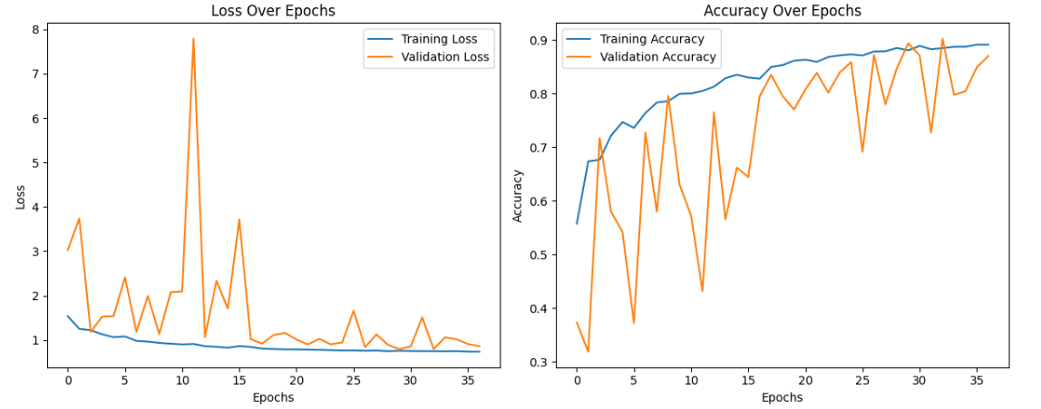
Quantitative Result
Figure 17. Quantitative Result

Slide 49
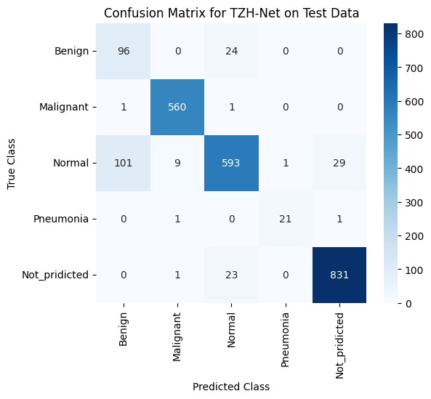
Confusion Matrix
Figure 18. Confusion Matrix

Slide 50
Comparative Analysis
Comparative Analysis of Different CNN architecture for Lung Diseases On CT_XRAY_Combine dataset.
Model | Accuracy (%) | Precision | Recall | F1-Score
VGG16 | 78.651 | 79.542 | 78.651 | 79.534
InceptionV3 | 77.627 | 84.609 | 77.627 | 75.700
Resnet | 80.244 | 86.151 | 80.244 | 79.558
DensNet | 65.242 | 56.758 | 65.242 | 58.258
TZH_Proposed_MCNN | 91.626 | 93.093 | 91.626 | 92.031

Slide 51
Endeavour

Slide 52
WBS
WBS # | WBS Deliverable | Activity # | Activity to Complete the Deliverable | Duration (# of Days) | Responsible Team Member(s) & Role(s)
1 | Feasibility Study | 1 | Project Work Performance Study | 10 days | Hadi,Touseef,Zeeshan
2 | Web Application | 2.1 | Requirements gathering and analysis | 15 days | Hadi,Touseef,Zeeshan
3 |  | 2.2 | Frontend development | 25 days | Hadi, Zeeshan

Slide 53
WBS
4 |  | 3.3 | Testing and debugging | 2 days | Touseef, Hadi
5 | Model Training, Development, and Evaluation | 4.1 | Data collection and preprocessing | 5 days | Touseef, Zeeshan
6 |  | 4.2 | Model selection and training | 5 days | Zeeshan
7 |  | 4.3 | Model evaluation | 10 days | Touseef, Hadi

Slide 54
8 | Backend Development | 5.1 | Backend Work | 25 days | Touseef, Hadi
9 |  | 5.2 | Model Integration | 5 days | Touseef, Hadi
10 | Testing And Debugging | 6.1 | White box Testing | 5 days | Zeeshan ,Hadi
11 |  | 6.2 | Black box Testing | 10 days | Touseef, Hadi

Slide 55
Best Practices/ Coding Standards
During the development phase of our application, we will imply on following practices and coding conventions:
Following Naming Conventions
Keeping the code modularized by one widget per dart file.
Avoiding Coded Literals
Using Git for Version Control
Avoiding Deep Nesting
Using functions instead of repeated code.
Promoting Single Responsibility Principle.

Slide 56
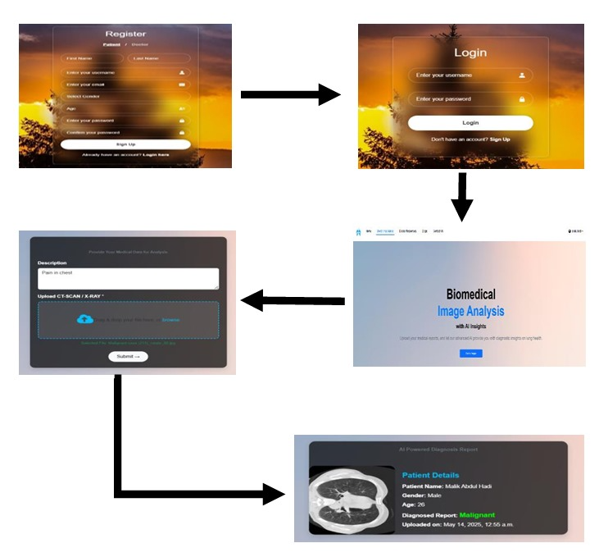
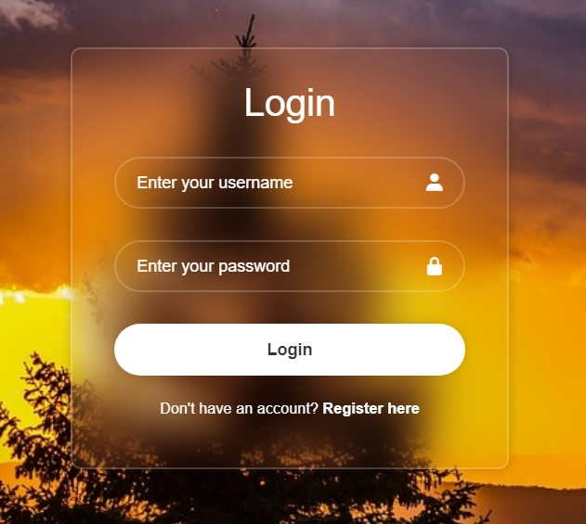
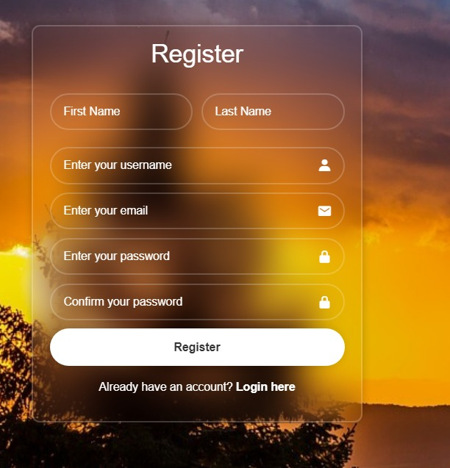
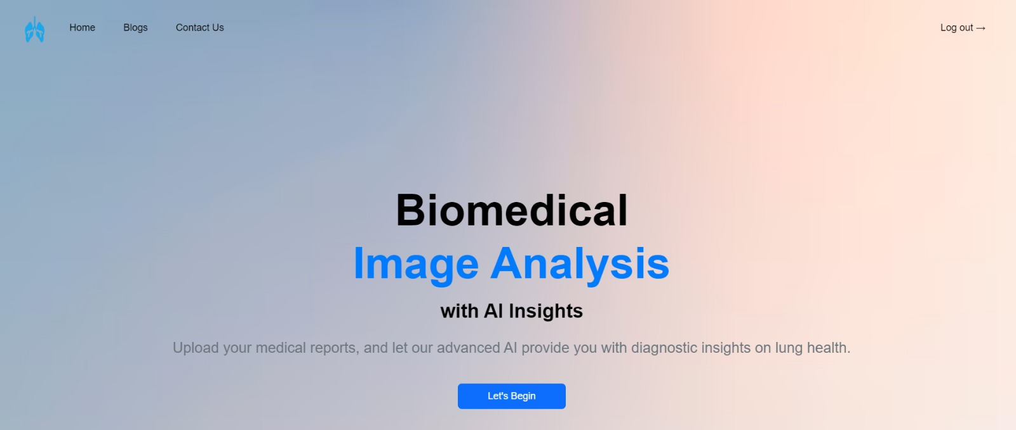
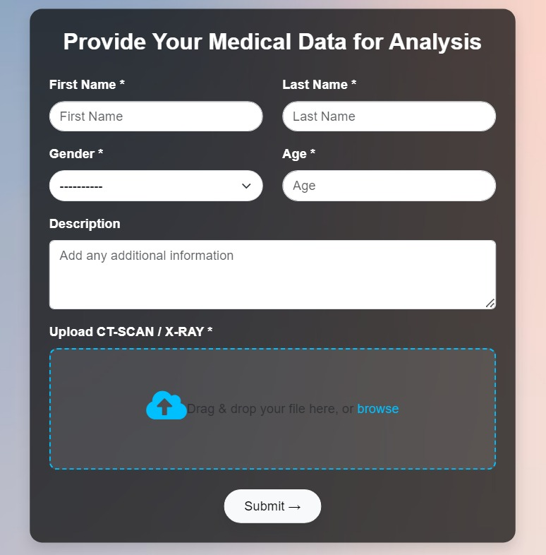
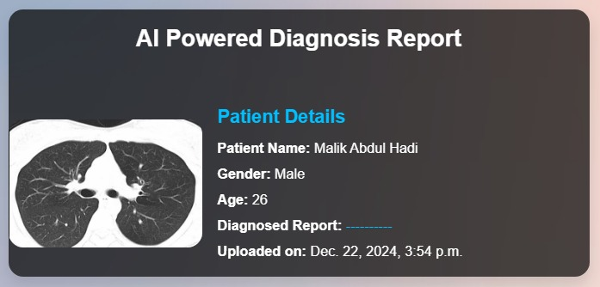
Prototype

Slide 57
Testing Summary

Slide 58
Testing Summary
We tested the MCNN model and the full Django-based web system. The model was evaluated using combined dataset and achieved over 91% accuracy, with strong precision and recall for detecting lung diseases from X-ray or ct scan images.
For the web system, we tested the entire workflow: patients could upload images, receive results, and request assistance from doctors.
Doctors were able to view reports, give suggestions, and prescribe medicines, while patients could see doctor feedback.
Admin functionalities were tested for managing users and maintaining the system. Integration, role-based access, and error handling were also verified.
The system performed reliably across all use cases and roles.

Slide 59
CONCLUSION AND OUTLOOK

Slide 60
Conclusion & Outlook (1/2)
In conclusion, this project successfully demonstrated the integration of a deep learning model MCNN with a user-friendly web application for the early detection of lung diseases from chest X-ray images.
The MCNN model achieved high accuracy by effectively capturing multiscale features, outperforming traditional CNNs and pre-trained models.
The Django-based web system allowed seamless interaction between patients, doctors, and admins. Patients could easily upload images and receive AI-based predictions, while doctors provided further assistance, and admins managed the platform.
The system was thoroughly tested and proved to be efficient, accessible, and reliable for real-world use.

Slide 61
Conclusion & Outlook (2/2)
The project can be extended by incorporating a larger and more diverse dataset to further improve model generalization.
Additional features like multi-language support, real-time doctor-patient chat, and automated report generation can enhance usability.
The model can also be deployed on a cloud platform or containerized for easier scalability.
Finally, incorporating other medical imaging types like integrating electronic health records (EHRs) could evolve this system into a more comprehensive diagnostic support tool.

Slide 62
References (1/3)
[1]M. Anthimopoulos, S. Christodoulidis, L. Ebner, A. Christe, and S. Mougiakakou, “Lung Pattern Classification for Interstitial Lung Diseases Using a Deep Convolutional Neural Network,” IEEE Trans Med Imaging, vol. 35, no. 5, pp. 1207–1216, May 2016, doi: 10.1109/TMI.2016.2535865.
[2] I. Sirazitdinov, M. Kholiavchenko, T. Mustafaev, Y. Yixuan, R. Kuleev, and B. Ibragimov, “Deep neural network ensemble for pneumonia localization from a large-scale chest x-ray database,” Computers and Electrical Engineering, vol. 78, pp. 388–399, Sep. 2019, doi: 10.1016/j.compeleceng.2019.08.004.
[3] S. K. Lakshmanaprabu, S. N. Mohanty, K. Shankar, N. Arunkumar, and G. Ramirez, “Optimal deep learning model for classification of lung cancer on CT images,” Future Generation Computer Systems, vol. 92, pp. 374–382, Mar. 2019, doi: 10.1016/j.future.2018.10.009.
[4] J. A. ALzubi, B. Bharathikannan, S. Tanwar, R. Manikandan, A. Khanna, and C. Thaventhiran, “Boosted neural network ensemble classification for lung cancer disease diagnosis,” Applied Soft Computing Journal, vol. 80, pp. 579–591, Jul. 2019, doi: 10.1016/j.asoc.2019.04.031.
[5] A. Bhandary et al., “Deep-learning framework to detect lung abnormality – A study with chest X-Ray and lung CT scan images,” Pattern Recognit Lett, vol. 129, pp. 271–278, Jan. 2020, doi: 10.1016/j.patrec.2019.11.013.
[6] M. G. Lanjewar, K. G. Panchbhai, and P. Charanarur, “Lung cancer detection from CT scans using modified DenseNet with feature selection methods and ML classifiers,” Expert Syst Appl, vol. 224, Aug. 2023, doi: 10.1016/j.eswa.2023.119961.

Slide 63
References (2/3)
[7] S. Yi, S. Qin, F. She, and D. Shao, “BSD: A multi-task framework for pulmonary disease classification using deep learning,” Expert Syst Appl, vol. 259, Jan. 2025, doi: 10.1016/j.eswa.2024.125355.
[8] G. Lakshmi G and P. Nagaraj, “Squeeze-Inception V3 with Slime Mould algorithm-based CNN features for lung cancer detection,” Biomed Signal Process Control, vol. 100, p. 106924, Feb. 2025, doi: 10.1016/J.BSPC.2024.106924.
[9] M. Nahiduzzaman et al., “Parallel CNN-ELM: A multiclass classification of chest X-ray images to identify seventeen lung diseases including COVID-19,” Expert Syst Appl, vol. 229, Nov. 2023, doi: 10.1016/j.eswa.2023.120528.
[10] J. L. Gayathri, B. Abraham, M. S. Sujarani, and M. S. Nair, “A computer-aided diagnosis system for the classification of COVID-19 and non-COVID-19 pneumonia on chest X-ray images by integrating CNN with sparse autoencoder and feed forward neural network,” Comput Biol Med, vol. 141, Feb. 2022, doi: 10.1016/j.compbiomed.2021.105134.
[11] A. Liu, S. Liu, and C. Wen, “MCFCN: Multi-scale capsule-weighted fusion classification network for lung disease classification based on chest CT scans,” Meta-Radiology, vol. 2, no. 2, Jun. 2024, doi: 10.1016/j.metrad.2024.100070.
[12] J. Arun Prakash et al., “Transfer learning approach for pediatric pneumonia diagnosis using channel attention deep CNN architectures,” Eng Appl Artif Intell, vol. 123, Aug. 2023, doi: 10.1016/j.engappai.2023.106416.

Slide 64
References (3/3)
[13] M. Sravani, M. K. Murthy, and S. Muppidi, “Utilizing Visual Geometry Group (VGG16) and InceptionV3 convolutional Neural Network (CNN) models for accurate diagnosis of lung cancer: an Artificial Intelligence (AI)-based approach,” Multimed Tools Appl, vol. 83, no. 19, pp. 57477–57494, Jun. 2024, doi: 10.1007/s11042-023-17807-3.
[14] Q. Qi et al., “Fully automatic pipeline of convolutional neural networks and capsule networks to distinguish COVID-19 from community-acquired pneumonia via CT images,” Comput Biol Med, vol. 141, Feb. 2022, doi: 10.1016/j.compbiomed.2021.105182.
[15] N. S. Shaik and T. K. Cherukuri, “Transfer learning based novel ensemble classifier for COVID-19 detection from chest CT-scans,” Comput Biol Med, vol. 141, Feb. 2022, doi: 10.1016/j.compbiomed.2021.105127.
[16] P. Gaur, V. Malaviya, A. Gupta, G. Bhatia, R. B. Pachori, and D. Sharma, “COVID-19 disease identification from chest CT images using empirical wavelet transformation and transfer learning,” Biomed Signal Process Control, vol. 71, Jan. 2022, doi: 10.1016/j.bspc.2021.103076.
[17] R. Khattab, I. R. Abdelmaksoud, and S. Abdelrazek, “Automated detection of COVID-19 and pneumonia diseases using data mining and transfer learning algorithms with focal loss from chest X-ray images,” Appl Soft Comput, vol. 162, Sep. 2024, doi: 10.1016/j.asoc.2024.111806.
[18] S. Rajeashwari and K. Arunesh, “Enhancing pneumonia diagnosis with ensemble-modified classifier and transfer learning in deep-CNN based classification of chest radiographs,” Biomed Signal Process Control, vol. 93, Jul. 2024, doi: 10.1016/j.bspc.2024.106130.

